Slide 1
AI-Powered Collections Strategy
Leveraging Agentic AI for Scalable, Fair, and Effective Debt Management at Geldium

Slide 2
How the System Works
Customer Data Input – Collect repayment history, credit score, income,
and customer interactions for a full risk profile.
Decision Logic Engine – AI model predicts delinquency risk
and maps it to tailored strategies.
Action Module – Sends personalized reminders, repayment plan offers,
or escalations based on risk.
Learning Loop – Tracks outcomes, refines the model,
and optimizes future interventions.
Notes:
Prompts to try:
Generate a simple outline for an AI collections system workflow, including inputs, decision logic, action triggers, and learning loop.
List 3–5 key customer attributes that would be most predictive for collections decision-making, and explain why each one matters.
Suggest examples of business rules and AI-driven actions the system could use at different risk levels (e.g., low, medium, high risk).
Create a rough sketch or step-by-step description of how customer data flows through the system from intake to action.

Slide 3
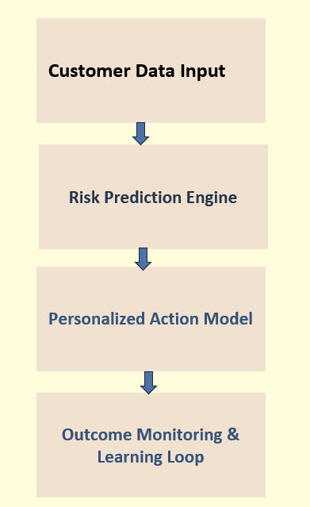
System Workflow Diagram

Slide 4
Role of Agentic AI
Autonomous AI
Predicts delinquency risk
Sends automated reminders
Adapts messages to customer behavior
Learns continuously from repayment data
Human Oversight
Approves or adjusts payment plans
Reviews special/edge cases
Handles customer disputes
Audits model fairness and compliance
Notes:
Prompts to try:
Explain how agentic AI could automate financial collections while keeping humans in critical decision points.
List 3–5 examples of collection actions, and classify each as best suited for full automation or requiring human oversight, with a brief reason why.

Slide 5
Responsible AI Guardrails
Fairness Checks → Identify and reduce bias across customer groups.
Explainability → Provide clear, understandable reasons for decisions.
Compliance → Ensure adherence to regulations (GDPR, ECOA, etc.).
Human-in-the-Loop → Keep agents involved for critical or sensitive decisions.
Notes:
Prompts to try:
List key fairness, transparency, and compliance practices to build into an AI-powered credit collections system.
Suggest specific ways to monitor and audit the system over time to ensure it stays fair, compliant, and effective.

Slide 6
Expected Business Impact
Business KPIs
Lower Delinquency: Aim for up to 25% reduction in late or missed payments.
Cost Efficiency: Automate outreach to reduce operational expenses.
Recovery Improvement: Boost repayment and recovery rates through timely interventions.
Scalability: Enable operations to handle larger volumes without proportional cost increases.
Customer Outcomes
Personalized Support: Tailored repayment plans aligned with individual circumstances.
Trust & Fairness: Consistent, unbiased treatment across all customer segments.
Transparency: Clear explanations of decisions and repayment options.
Positive Experience: Shift collections from punitive to supportive interactions.
Notes:
Prompts to try:
Suggest KPIs for an AI-powered collections strategy that balances business outcomes with customer fairness.
Describe 2–3 ways an AI collections system could improve both operational efficiency and customer experience.

Slide 7
Thank You

